Slide 1

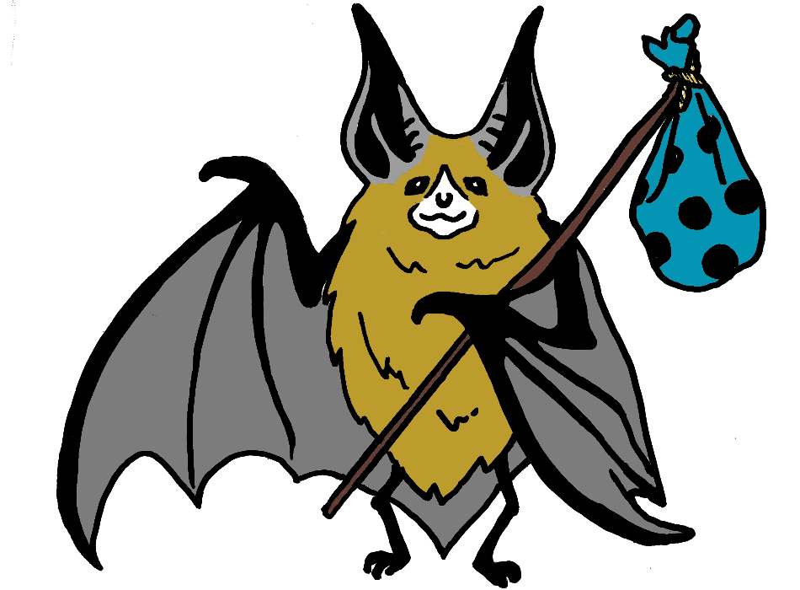

Bats Astray
about bats
Bats are protected wildlife, and it is illegal to kill or harm them or to keep them in captivity
Bats provide valuable pest control by eating millions of insects (like those pesky mosquitos!)
17 bat species are native to Canada – all are insect-eaters
Three of Canada’s bat species are listed as Endangered under the federal Species at Risk Act
Our most common bat species, the little brown myotis, weighs less than 3 nickels but can live over 30 years!
Please check for bats!
Bats sometimes roost on campers and trailers. Bats have been found in awnings, and up inside umbrellas too!
If those bats aren’t discovered and removed before campers leave, the bats could be accidentally taken to other areas of the province or even right across the country!
Please don’t take any bats with you!
Please check your campers, tents, awnings and umbrellas before you leave
Your address here
http://www.yourwebsite.com/
For More Info, please contact:
Your contact

Slide 2
IF YOU NEED HELP
If you have been bitten or scratched by a bat, see a doctor immediately as you will need a rabies vaccination. Do not panic, very few bats have rabies, but you must see a doctor all the same.
If you need help dealing with a bat on your camper, or if you’ve found a bat that seems injured or sick, please contact
<contact info>
AS YOU PACK UP YOUR CAMP if you see a bat on the outside of your camper or IN AN AWNING
Keep an eye on the bat, and keep children and pets away from it. Like most wildlife, bats will bite if they are handled.
The bat will probably leave on its own. Make sure the bat has left before you drive away from the campground
Do not fold your umbrella or retract your awning if a bat is present there
If the bat does not leave on its own, carefully and gently nudge the bat with a broom to remove it from your camper or umbrella
If the bat does not fly away, place it on a tree or shrub, high enough that children and pets cannot reach it
how you can help
BEFORE YOU LEAVE YOUR CAMP
Inspect the outside of your camper, trailer or tent before you leave to make sure no bats are roosting there
Check the underside of your umbrella packing it away, and check your awnings before rolling them up
If possible, inspect your awnings and umbrellas and close them before you go to bed
WHEN YOU ARRIVE AT YOUR CAMP
Carefully inspect awnings, umbrellas and pop-up trailers as you open them
If you find a bat, report it to local wildlife (conservation) officers (see Contact Info), and if possible, carefully contain the bat (see instructions in brown text box).
Lost bats
Bats that are accidentally taken to new areas may not be able to find safe roost sites or places to hibernate.
They may not survive their move.
FOR MORE INFORMATION ON BATS
Local bat organizations (BCBAT, ABAT, community bat program etc.)
White-nose syndrome https://www.whitenosesyndrome.org/
Bat Conservation International www.batcon.org/why-bats/bats-are/bats-are-important
More?
Remember, never touch a bat with your bare hands. Use a thick towel, oven mitts or a leather glove to remove a bat, or GENTLY nudge the bat into a container using a whisk broom.

